Slide 1
MECO 2603 - MEDIA RELATIONS
LECTURE #4
BEFORE WE START:
GROUP EXERCISE
On the list FIVE (5) different media across print, broadcast and online that you could pitch a news story into.
Unit Co-ordinator, Lecturer: Tiffanny Junee
Email: tiffanny.junee@sydney.edu.au
Twitter: @TiffannyJunee
Consultation by Appointment
Wednesdays 12noon – 12:45pm
#SydneyMedia

Slide 2
Agenda
Notes:
ReadingsL
(Chapter 4) Campaign Tactics – Written, Spoken, Acted and Imagined
(Chapter 5) The News Release
(Chapter 6) Developing Media Relationships Around News

Slide 3
Campaign Tactics
Written | Spoken | Acted | Imagined
Form basis of Campaign’s meaning. They must present a single frame for an issue or event
Uncontrolled Tactics: Backstory/ Backgrounder | Face-to-face (person, telephone, Skype) | Media Conference | Interventions pictures
Media Release / News Release | Interviews | CSA - Television | Videos
Feature Story | Speeches | Community Meetings | Music
Letter to the Editor | Word of Mouth | Demonstrations (direct action) | Drama
Controlled Tactics: Newsletters | CSA – Radio | Factory Tours
Flyers |  | Trade Displays
Pamphlets |  | Street Theatre
Brochures
Handbooks
Annual Reports
Books
Notes:
According to Stanton 2007 p. 51

Slide 4
The Backgrounder
A Backgrounder should:
  Provide company information that doesn’t necessarily have a place in a news release although it does support the news story.
  Should substantially reduce the media’s knowledge gap on the topic/ company / brand / event
  Provides evidence of thorough, factual research
The backgrounder is written for the media to use
News Releases should be:
  In the expected format.
  Factual

Slide 5
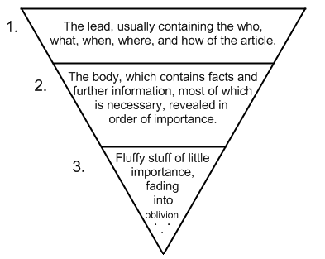
The News Release
News Release = a Ritual tactic or embedded practice in the subfield of Media Relations
ie: Clients expect it to be written, Media Relationists expect to write it
and journalists and editors expect to receive them ☺
News Releases should be:
  In the expected format: heading: Media Release, date, headline, company name / logo, contact details: For further information, interviews and pics; Name, Company, email, mobile, twitter and instagram
  Grammatically correct -no spelling errors and correct use of punctuation;
  Factual;
  Same structure as a news story: inverted pyramid
Notes:
Inverted pyramid image - https://sites.google.com/site/spiritofrevolution/invertedpyramid1.png
Colourful reference at – PR reference though http://meganwinkler.files.wordpress.com/2011/10/inverted_pyramid1.jpg

Slide 6
Rules for Writing a News Release
Stanton (2007) lists the Do’s and Do Not’s of Writing News Releases (pp. 81-82).
What are they and why are they important?

Slide 7
Developing Media Relationships around News
Building a relationship with media requires:

Slide 8
Dealing with Uncontrolled Media:
Who would we approach and how?
What are they looking for in a story…?
The Editor | The Media Relations Approach
News Editor, Daily Telegraph
Features Editor, Daily Telegraph
Sports Editor, Daily Telegraph
The Producer | The Media Relations Approach
Today Today
Segment Producer, The Today Show
Producer, #TenLateNews

Slide 9
Media Relations ‘Speak’
Talking Campaign Strategy: ROPE / RACE (Research, Objectives/Action, Perform/ Communicate, Evaluate)
Client Relations | Media Relations
Client / Product Objectives Key Messages | Stakeholders (agendas) Agents Forces
What are we trying to say | Who are we talking to…?
Talking Campaign Tactics:
Theories | Strategy | Campaign Tactics
Framing | Understanding media ideologies embedded in agendas. | The Media Relations Toolkit
How are we framing our story? | Who are our target audience? | How are we going to ‘speak’ with our target audience?
Relationship Building | How are we going to best speak with our target audience?
Knowing when to talk to the media and what to say to them

